Slide 1
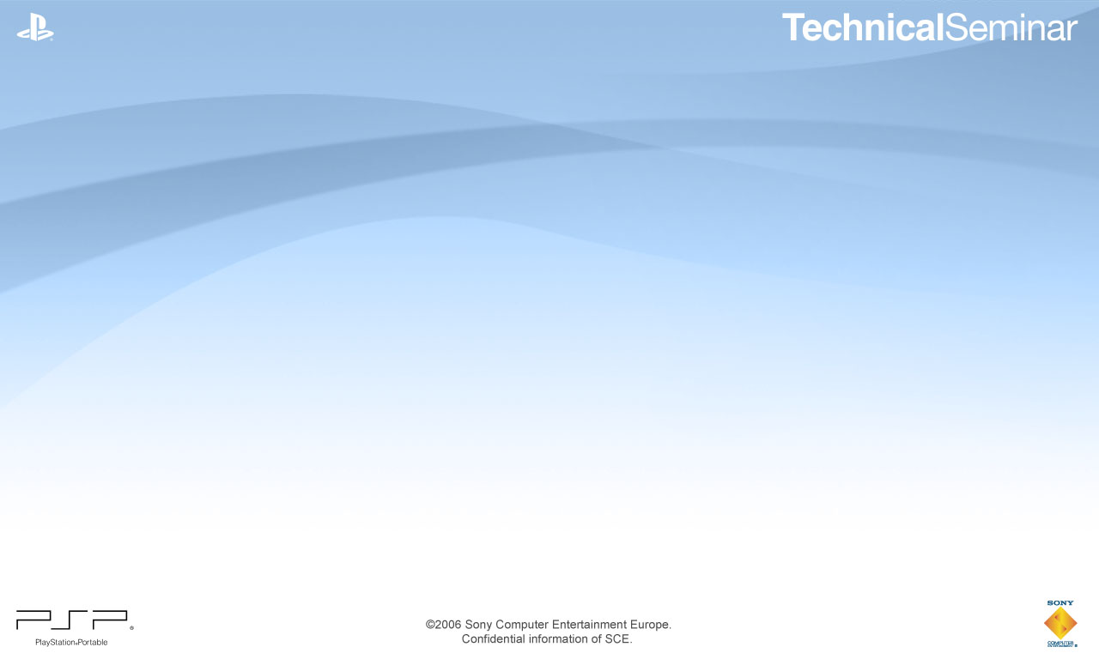
PlayStation®Portable
Advanced Graphics Techniques
Igor Makaruks - SCEE

Slide 2
Agenda
Introduction to hardware
  VRAM Configuration
Common problems
  Precision
  Texture mapping
Advanced techniques
  Stencil Shadow Volumes/Environment Mapping
sceePspGu

Slide 3
Graphics Engine
Standard Fixed Function pipeline
  HW T&L, Texture filtering, Mip-Mapping, Vertex Blending, Fogging, Gouraud Shading
OpenGL-like rasterizer
166MHz maximum (currently allowed to be run at 111MHz)
Simple 32-bit commands
Texture Compression (DXT1, DXT3, DXT5)
Hardware Guard-band and Polygon Clipping

Slide 4
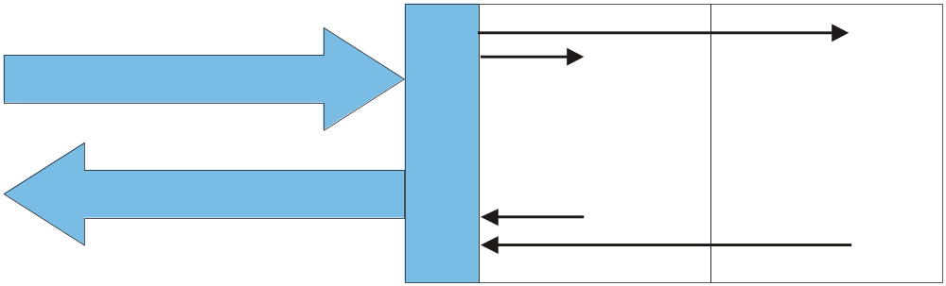
VRAM Configuration
2 Memory Devices (1MB each)
128-bit Read + 128-bit Write
Data can be read and written at the same time (free transparency)
Graphics and normal (linear) mode
@128
Mem 0
Bank 0
Mem 0
Bank 1
@128
@128
Mem 1
Bank 0
Mem 1
Bank 1
@128

Slide 5
VRAM Configuration
VRAM = two [1024-page x 32 column x 128-bit x 2 bank] memory macros
Addressing modes:
  Linear mode
  Graphics mode
Each bank = 32 rows (32*16 = 512 bytes)
20 |  |  |  |  |  |  |  |  | 11 | 10 | 9 | 8 |  |  |  | 4
Col[9:0] |  |  |  |  |  |  |  |  |  | M | Bx | Row[4:0]
20 | 19 | 18 | 17 | 16 | 15 | 14 | 13 | 12 | 11 | 10 | 9 | 8 | 7 | 6 | 5 | 4
Row[9:3] |  |  |  |  |  |  | Bx | Col[4:2] |  |  | Row[2:0] |  |  | M | Col[1:0]

Slide 6
VRAM Configuration
Set up addressing to linear mode: sceGeEdramSetAddressTranslation(0)
Fill it with predefined colours
Notes:
4 lines on the screen of this presentation = 1 memory line

Slide 7
VRAM Configuration
Switch to graphics mode
  Draw Buffer
  Depth Buffer
Notes:
Switch to Graphics Mode and observe that the values that have been stored linearly now are grouped together as rectangles.

Slide 8
VRAM Configuration
DrawBuffer
Memory 0
Memory 1
Bank 0
Bank 1
Notes:
We know which value to which Memory/Bank was written that is why we can create this table

Slide 9
VRAM Configuration
DrawBuffer
Memory 0
Memory 1
Bank 0
Bank 1

Slide 10
VRAM Configuration
DrawBuffer
Memory 0
Memory 1
Bank 0
Bank 1

Slide 11
VRAM Configuration
DrawBuffer
Memory 0
Memory 1
Bank 0
Bank 1
No page fetch!

Slide 12
VRAM Configuration
DrawBuffer
Depth Buffer
Memory 0
Memory 1
Memory 1
Memory 0
Bank 0
Bank 1
Bank 1
Bank 0
Different Memory Devices and Banks

Slide 13
VRAM Configuration
Optimal polygon size
Memory 0
Memory 1
Bank 0
Bank 1
Width of 2 banks

Slide 14
VRAM Configuration
Implications
  When clearing the screen
    64 pixels wide rectangles are optimal for 16-bit screen
    32 pixels wide rectangles are optimal for 32-bit screen
  The optimal random (non-aligned) polygon width is bank width
    32 pixel width polygons - optimal for 16-bit screen
    16 pixel width polygons - optimal for 32-bit screen
  If polygon width is larger than the optimal polygon size - Graphic Engine will stall mainly on VRAM memory accesses

Slide 15
VRAM Configuration
Fillrate
 | Depth Buffer OFF | Depth Buffer ON
16-bit | 0.441 MPix/s | 0.432 MPix/s
32-bit | 0.405 MPix/s | 0.388 MPix/s

Slide 16
VRAM Configuration
Few more words
  sceGeEdramSetAddressTranslation() specifies most efficient memory width in bytes when VRAM is used in graphics mode
  See “Graphics and VFPU programming on PSP”
  by Sébastien Rubens for additional information
  (also available on the psp-edu site)

Slide 17
VRAM Configuration
How can I save some memory?
  Using 16-bit front buffer and 32-bit back buffer:
  Render to back buffer
  Apply full screen effects and render to front buffer

Slide 18
Using 16bits front buffer and 32bit back buffer (2)
Render to Draw Buffer
Wait for VBLANK
Downsize to the Display Buffer + full screen effects
Note: VRAM layout does not change
Display Buffer
16-bit
Draw Buffer
32-bit
(1)
(3)
Depth Buffer
16-bit
(1)

Slide 19
Using 16bits front buffer and 32bit back buffer (2)
Display Buffer
16-bit
Display Buffer
16-bit
Frame 0:
  Render to Draw Buffer
  Downsize to the Temporary Display Buffer
  Change of frame
Draw Buffer
32-bit
(1)
Draw Buffer
32-bit
(2)
Depth Buffer
16-bit
(1)
Draw Buffer
16-bit
(2)
Frame 0

Slide 20
Using 16bits front buffer and 32bit back buffer (2.1)
Display Buffer
16-bit
Display Buffer
16-bit
Frame 0:
  Render to Draw Buffer
  Downsize to the Temporary Display Buffer
  Change of frame
Draw Buffer
32-bit
(1)
Draw Buffer
32-bit
(2)
Depth Buffer
16-bit
(1)
Draw Buffer
16-bit
(2)
Frame 0

Slide 21
Using 16bits front buffer and 32bit back buffer (2.2)
Display Buffer
16-bit
Depth Buffer
16-bit
Draw Buffer
16-bit
(5)
Frame 1
  Render to Draw Buffer
  Downsize to the Temporary Display Buffer
Conclusion
  You can avoid to draw directly in the display buffer and save the time for a buffer copy!
  Be careful with buffer alignment issues (perhaps you will use a bit of extra memory)
Draw Buffer
32-bit
(5)
Draw Buffer
32-bit
(4)
Draw Buffer
32-bit
Draw Buffer
16-bit
(2)
Display Buffer
16-bit
Display Buffer
16-bit
Frame 0
Frame 1

Slide 22
Common graphics problems

Slide 23
GE – Precision Problems
GE matrix calculations are performed in 24bits
Surface Engine
HOSTIF
BLEND
SUBDIV
TANDL
CLIP
Rendering Engine
SETUP
TXM
PIXOP
DRAMIF
eDRAM
2MB

Slide 24
GE – Precision Problems
GE internal calculations are performed in 24bits
Transform & Lighting unit (matrices are multiplied here)
Surface Engine
HOSTIF
BLEND
SUBDIV
TANDL
CLIP
Rendering Engine
SETUP
TXM
PIXOP
DRAMIF
eDRAM
2MB

Slide 25
GE – Precision Problems
That can cause possible artifacts:
  Model shaking
  Clipping issues
Surface Engine
HOSTIF
BLEND
SUBDIV
TANDL
CLIP
Rendering Engine
SETUP
TXM
PIXOP
DRAMIF
eDRAM
2MB
Notes:
T&L is after Blending unit and before Clipping that is why it is breaking animations and clipping.

Slide 26
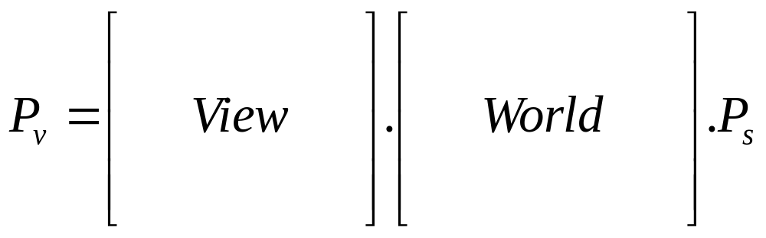
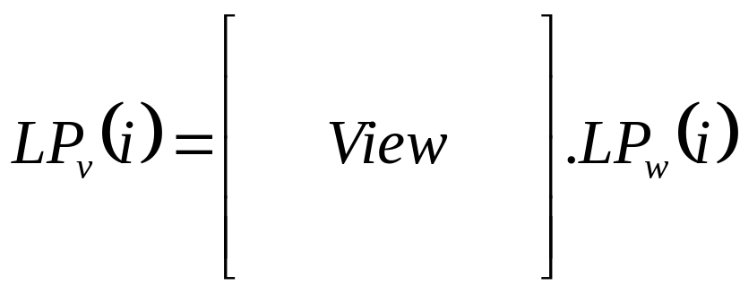
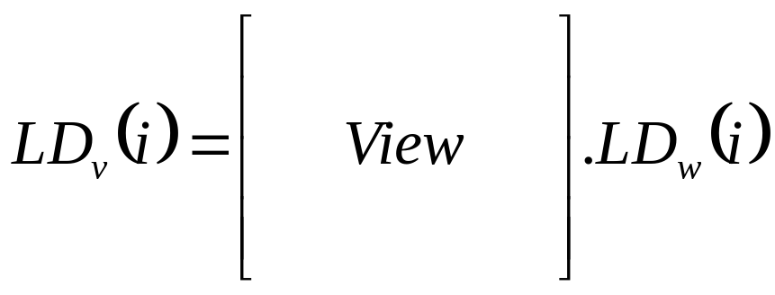
GE – Precision Problems
The GE hardware transforms the position from local space to view space
The GE hardware transforms the light position/direction from world space to view space

Slide 27
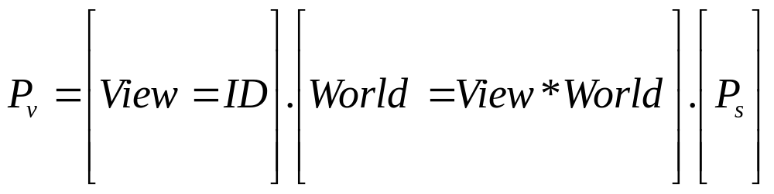
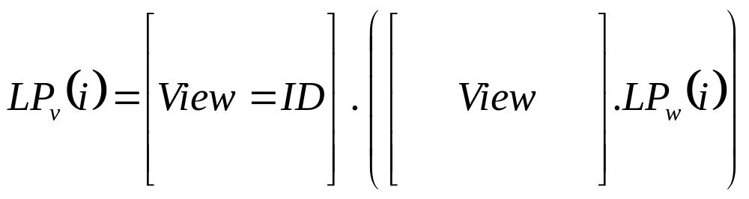

GE – Precision Problems
The solution
  Pre-multiply the View and World matrices to add precision on vertex positions
  Pre-transform the Light position and direction to produce a correct lighting result

Slide 28
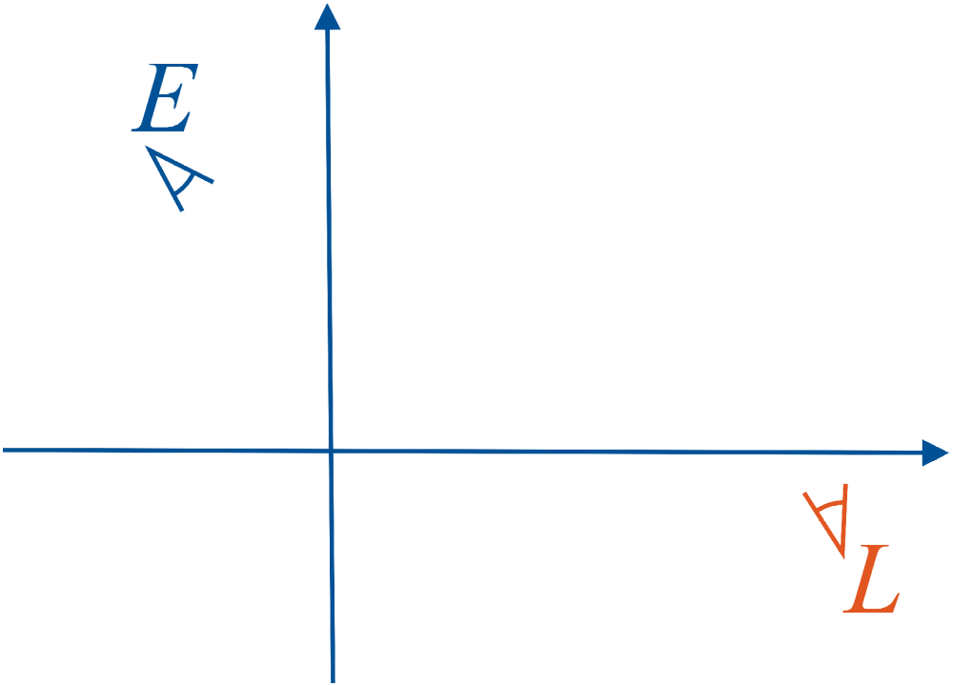

GE – Precision Problems
World Space
Object is in Model Space

Slide 29
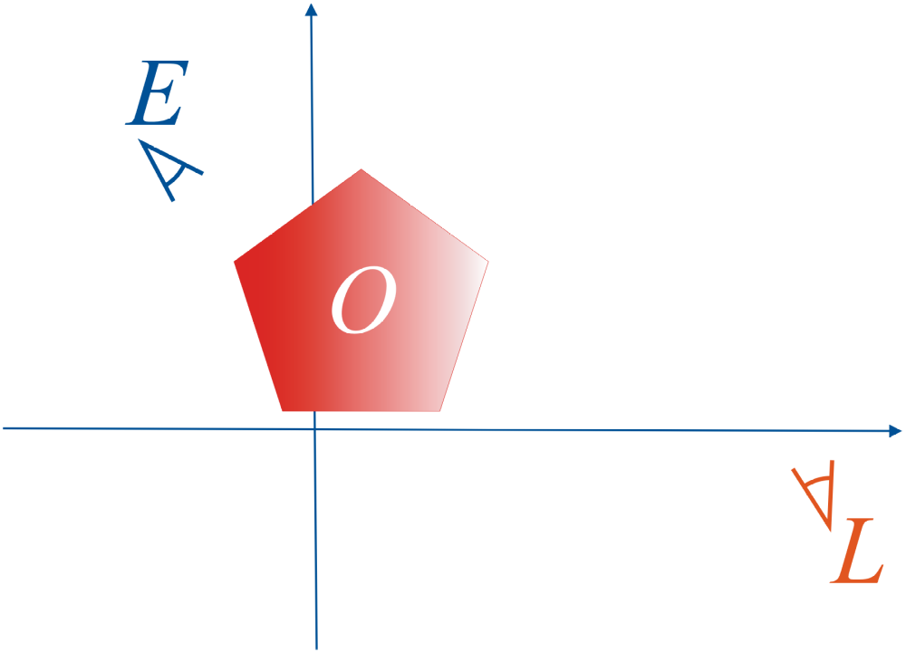
GE – Precision Problems
World Space
Object transformed by World Matrix

Slide 30
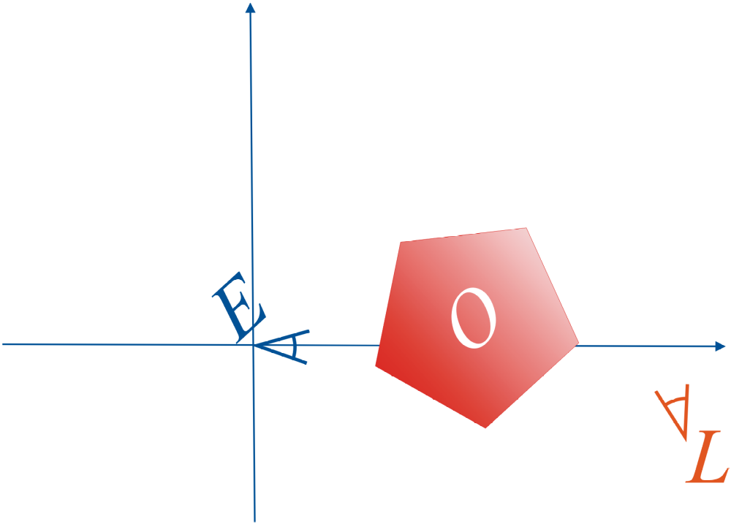
GE – Precision Problems
View Space
Transforming O into View Space
  E is center of origin
  O multiplied by View Matrix
Notes:
Tranform O by View*World matrix

Slide 31
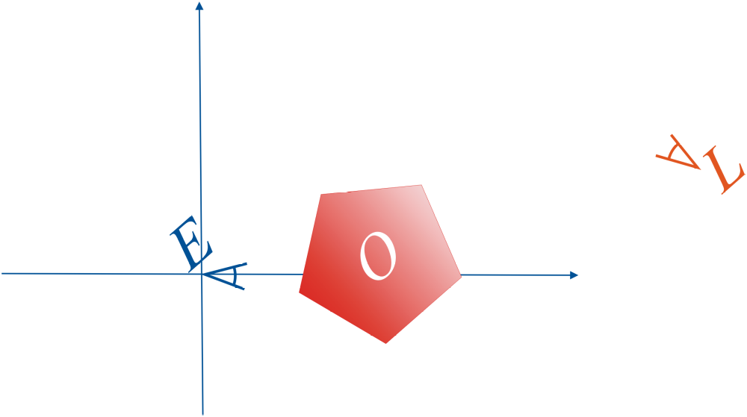
GE – Precision Problems
Transforming L explicitly into View space
Sample Code will be included in
  sceePspGu

Slide 32

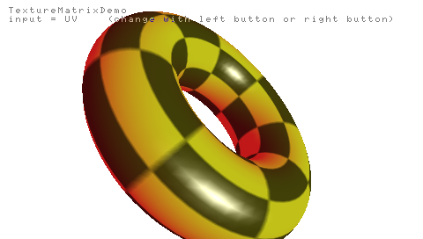
GE - Texture Coordinate Generation
UV Mapping

Slide 33


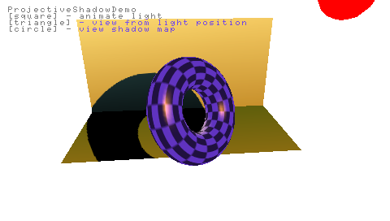
GE - Texture Coordinate Generation
Projection Mapping
  are obtained from Projection Matrix multiplied by Position, Normal or Texture Mapping Coordinates

Slide 34
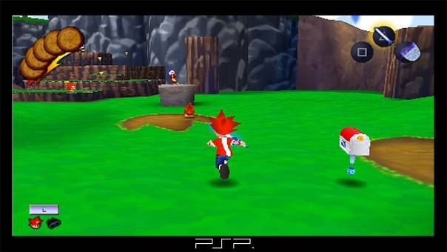
Graphic Engine - Shadows
Some implementations…
… can be improved

Slide 35
Graphic Engine - Shadows
Pre-computed projected shadows
  Assume the shadow texture is always the same
  Project pre-computed texture to receiver
Projected shadows
  Render to shadow buffer using the shadow caster model (or simplified model)
  Project the texture to receiver
Shadow Volumes (or Stencil Shadows)
  see next slide

Slide 36
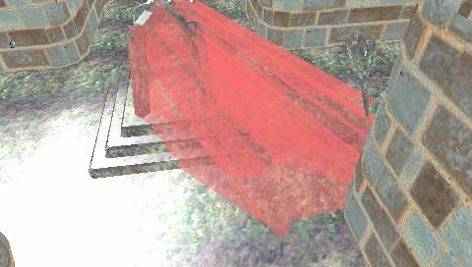
Graphic Engine - Shadows
Stencil Shadow Volumes Sample
  Uses the stencil to draw shadow volume front faces (+1) or back faces (-1)…
  Be careful with stencil saturation

Slide 37
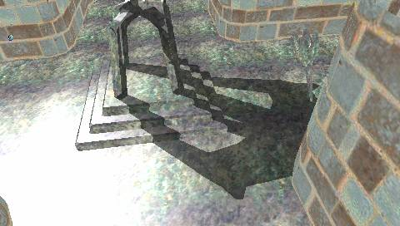
Graphic Engine - Shadows
Stencil Shadow Volumes Sample
  Use the stencil value to determinate if a point in inside or outside the shadow volume

Slide 38

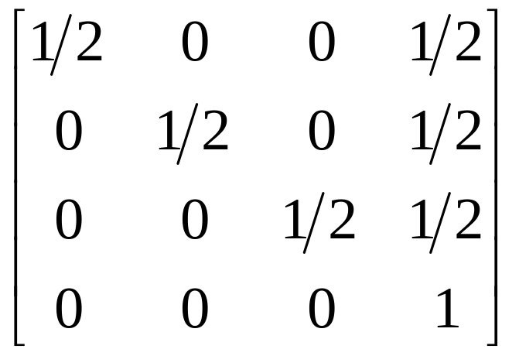

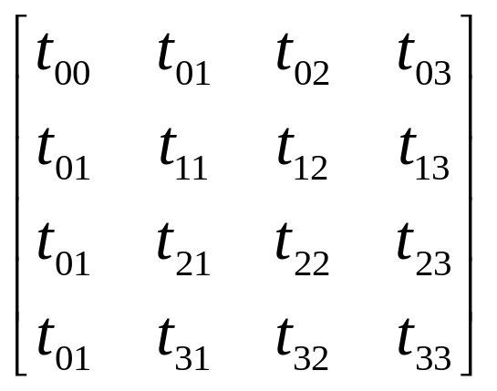

GE - Texture Coordinate Generation
“Standard” (non-PSP) Hardware Projection Mapping
Transform position vector
.. into View Space (of projector)
using a 4x3 matrix
Compute 4x4 Texture Projection Matrix
… pre-multiply it with Texture Scale/Translation Matrix
Obtain texture coordinates

Slide 39

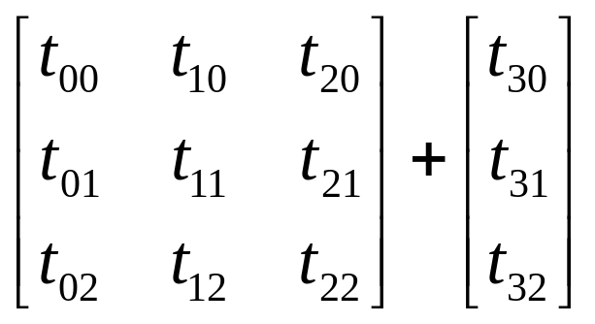
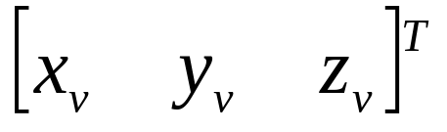

GE - Texture Coordinate Generation
PSP GE Projection Mapping
Transforms position vector
.. into View Space (of projector)
using World*View (4x3) matrix
Transform by 4x3 Texture Projection Matrix
Obtain texture coordinates

Slide 40

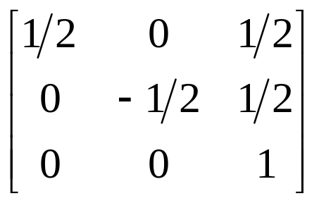
GE - Texture Coordinate Generation
PSP GE Projection Mapping
Make sure that resulting values
Can be achieved by using transform

Slide 41
GE - Texture Coordinate Generation
PSP GE Projection Mapping
sceePspGu provides functions to help:
  TexFrustum()
  TexOrtho()
  TexPerspective()

Slide 42
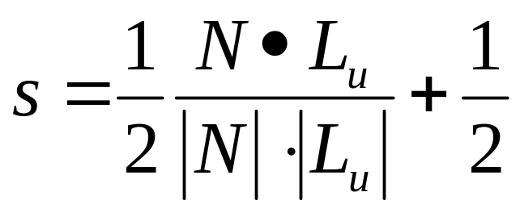
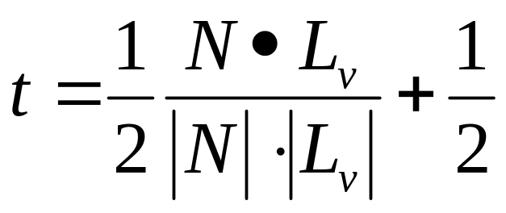

GE - Texture Coordinate Generation
Shade Mapping

Slide 43
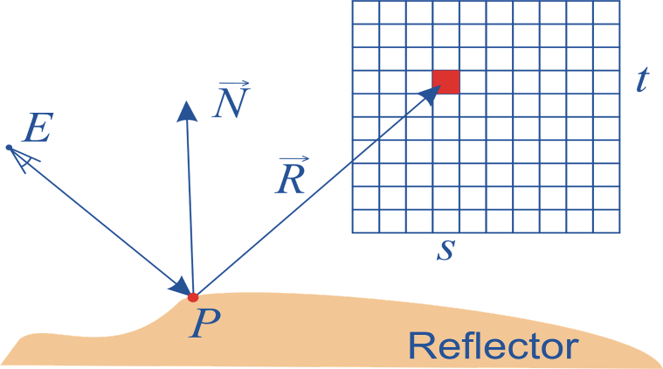
GE - Texture Coordinate Generation
Environment Mapping?

Slide 44

GE - Texture Coordinate Generation
We need to compute this:
Impossible on GE
Use VFPU
  Faster than you would expect
    See “Advanced PSP® Programming” for details

Slide 45
sceePspGu

Slide 46
sceePspGu
Initially was developed as alternative to libgu
Development directions
  API: uses enumerated types to benefit from compiler checks
  Additional features, ex: projective textures functions
  Performance increase
  Libgu compatibility (to a certain extent)
  Additional sample codes
    To demonstrate what is possible to achieve on GE
    To highlight hardware details that are not documented

Slide 47
sceePspGu
Why use it?
  It supports the vpfu asm patch / intrinsics
  It is often quicker than libgu
  It has useful extra functions
    for projective mapping
    for setting up render target very easily and without bugs
    per primitive mipmapping functions (sceePspGuu)
    …
  You can use the library on PC to precompute your display lists
  You can specify multiple contexts for multiple display lists
  …

Slide 48
sceePspGu
sceePspGu 1.7.0 has been released
  Compatible with SDK 2.8
  Fixed bugs (ex: colour double)
  Added sample codes

Slide 49
Thanks
SCEE Technology Group
Sébastien Rubens, SCEI Euro R&D

